Slide 1
US pResidential ELECTION
An analysis based on demographic data

Slide 2
Outline
GOAls
Analysis
1
2
3
4
DATA
REsults

Slide 3
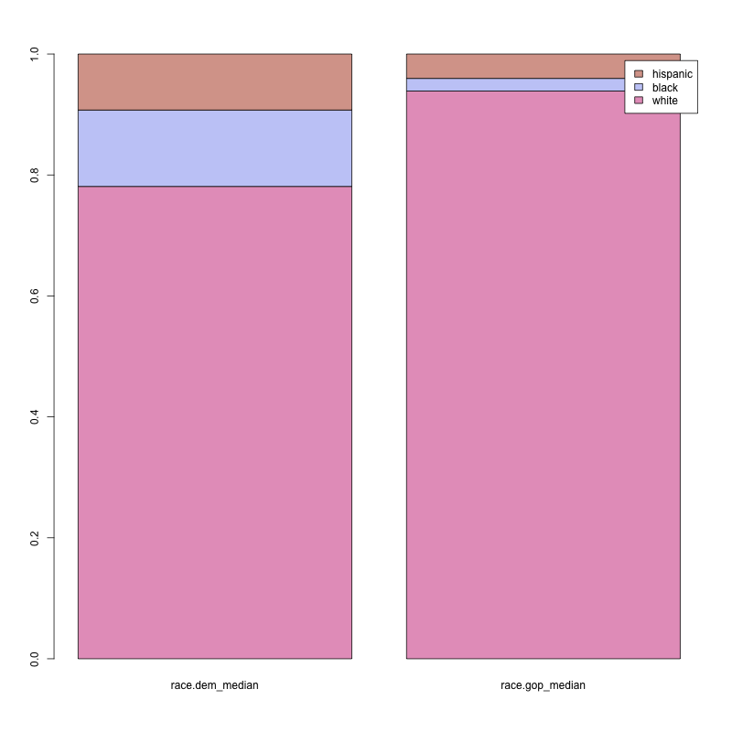
Goals
Population segments effect
Swing states
How do population segments affect the electoral results?
Is it possible to identify possible swing states to guide a possible campaign strategy?

Slide 4

Data
COunTY-level
Compositions
Counties are the statical units of the dataset
Ethnical, Educational and Age compositions of the counties
Summary variables
Electoral results
Median Income, unemployement rate, total elector count
Related to 2012, 2016 and 2020

Slide 5
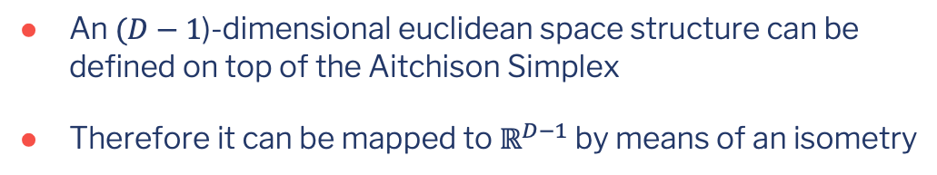
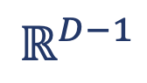
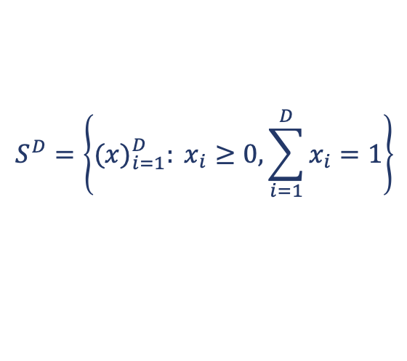
The compositional data analysis approach
$$S^{D}=\left\{{(x)}_{i=1}^{D}: x_{i}≥0, \sum_{i=1}^{D}{x_{i}=1}\right\}$$
$$ℝ^{D−1}$$
An $(D−1$)-dimensional euclidean space structure can be defined on top of the Aitchison Simplex
Therefore it can be mapped to $ℝ^{D−1}$ by means of an isometry

Slide 6
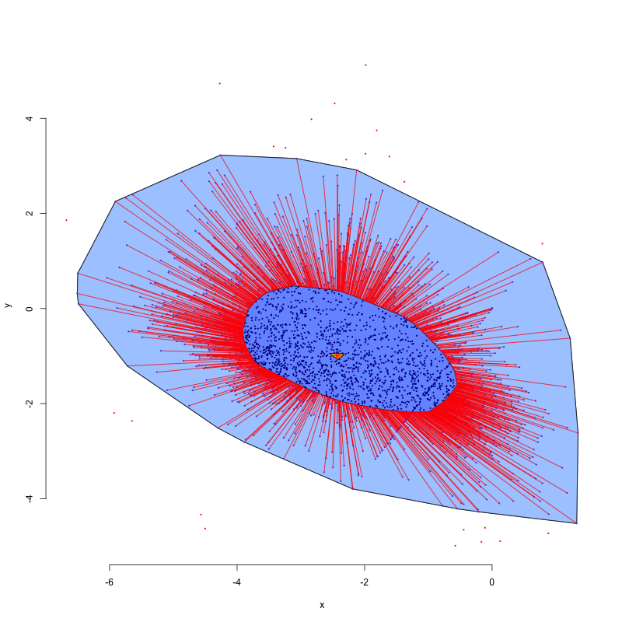
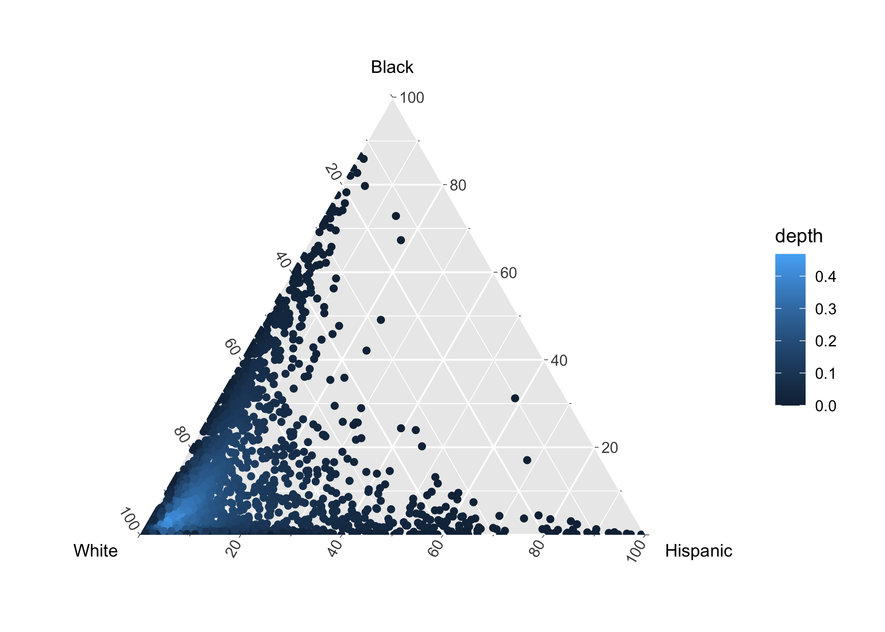
Depth exploration: ethnical composition

Slide 7
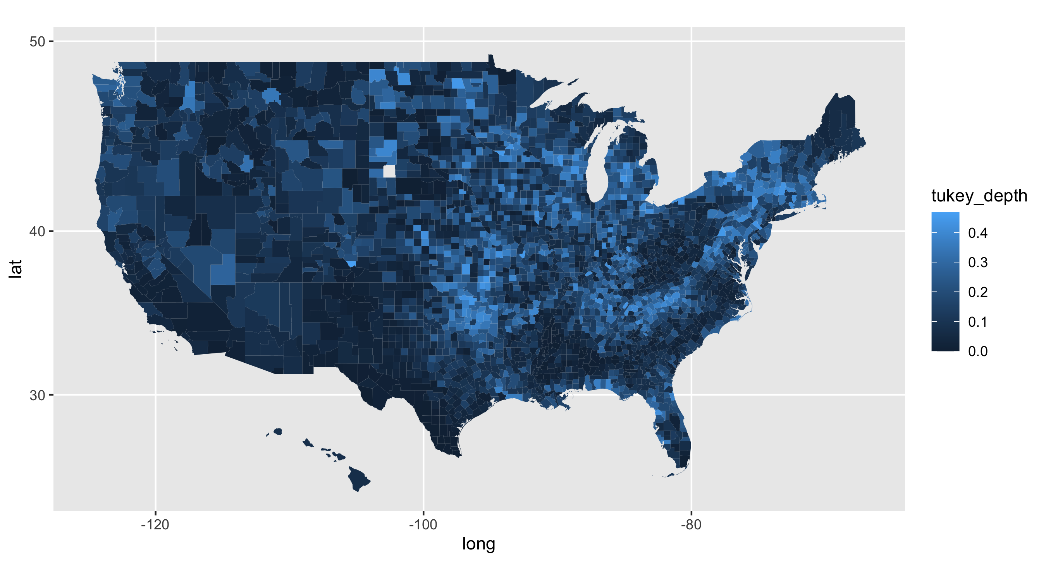
Depth: Exploration ethnical composition

Slide 8
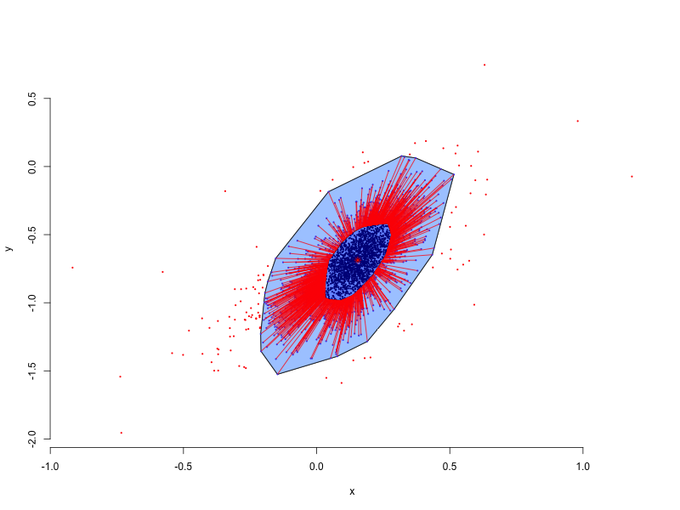
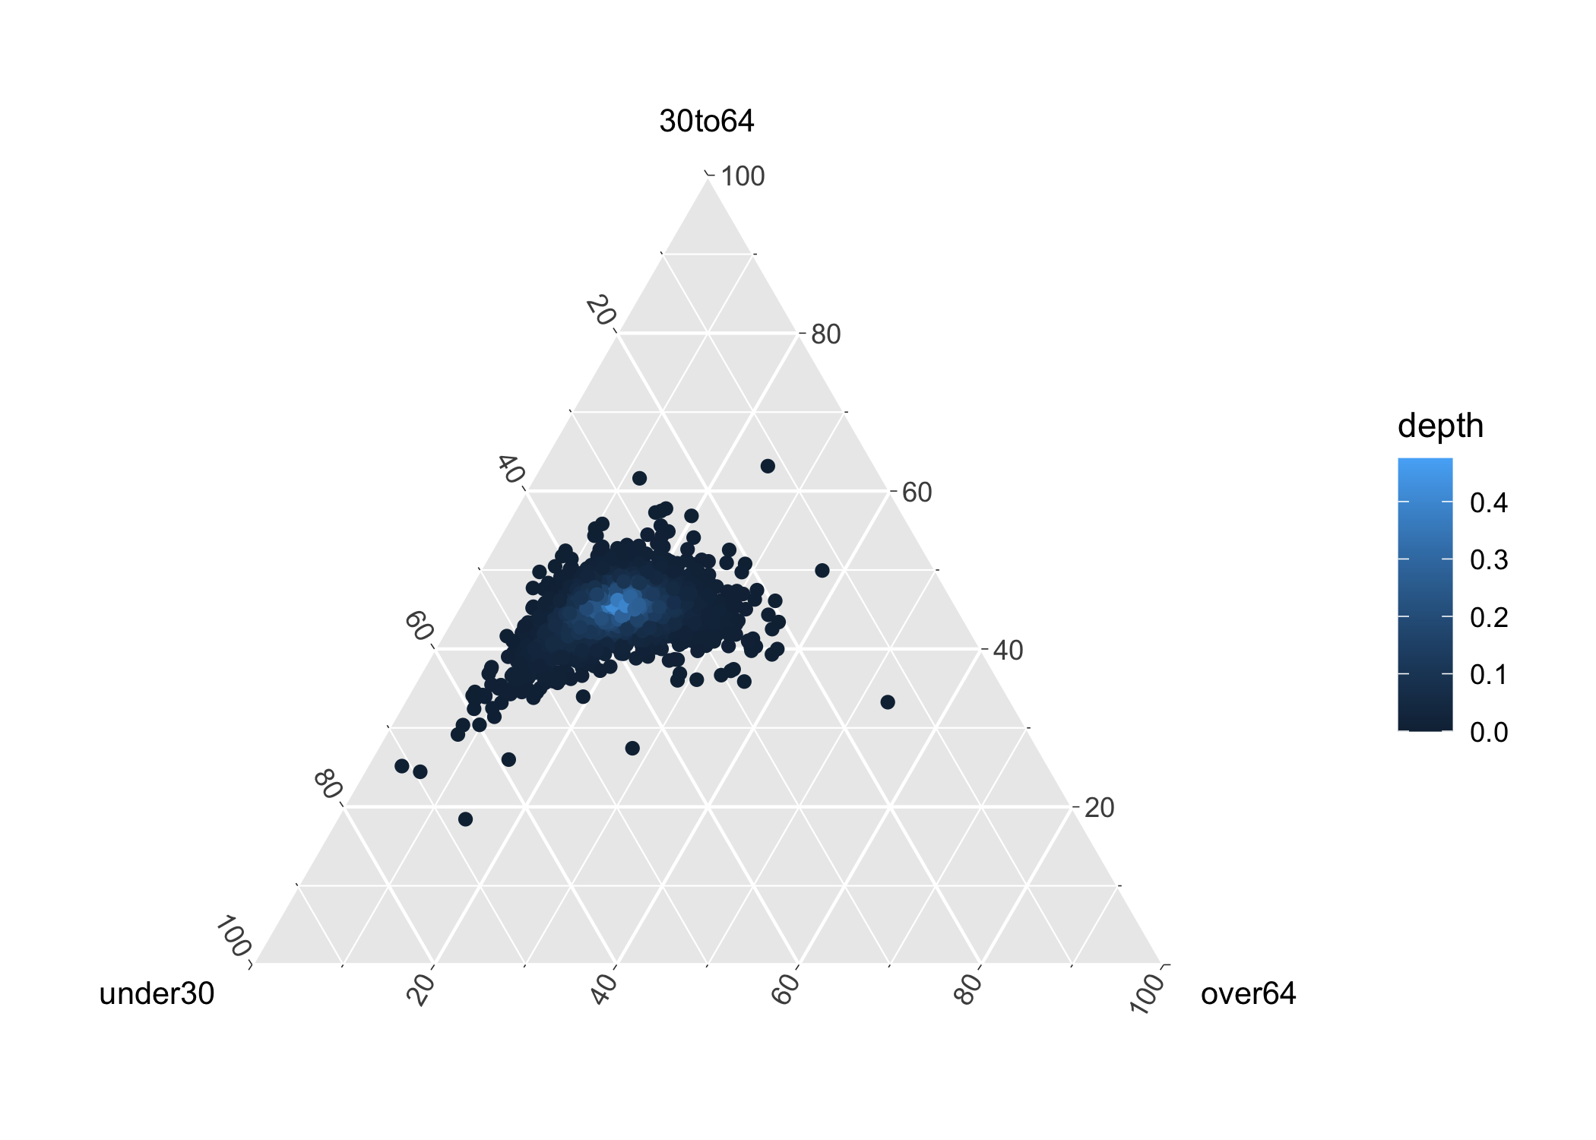
Depth exploration: Age composition

Slide 9
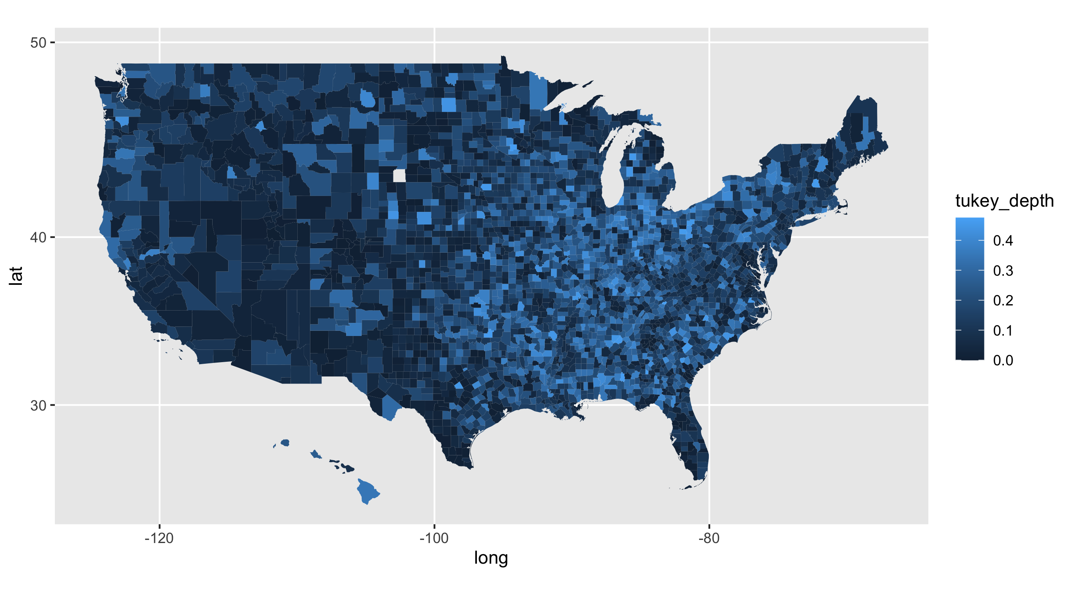
Depth exploration: Age composition

Slide 10
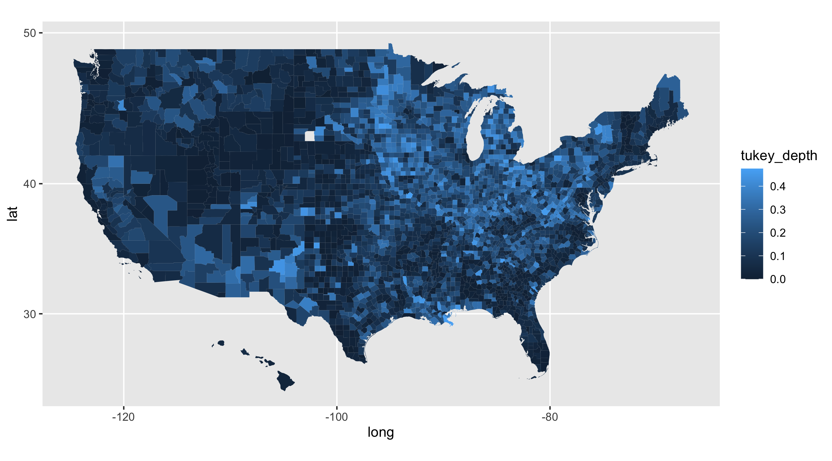
Depth exploration: electoral results

Slide 11
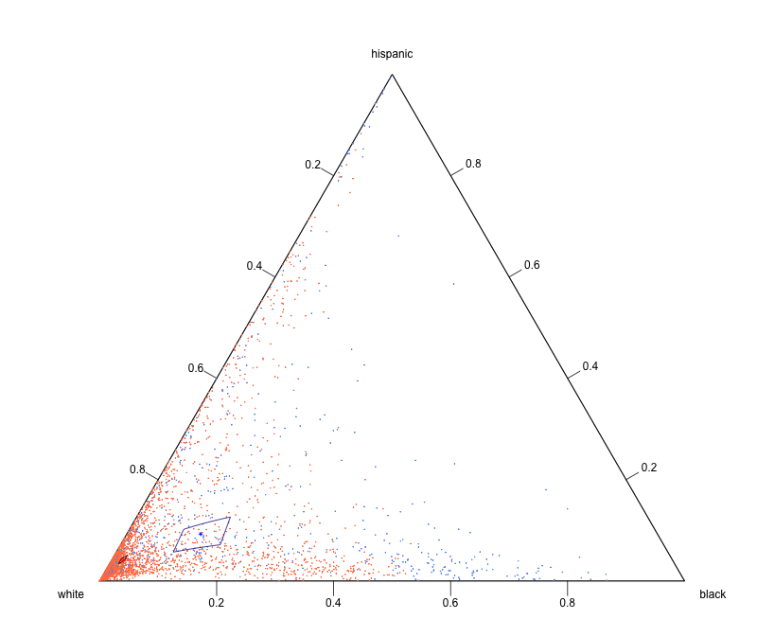
Permutational t-test: ETHNICAL COMPOSITION
p-val = 0

Slide 12
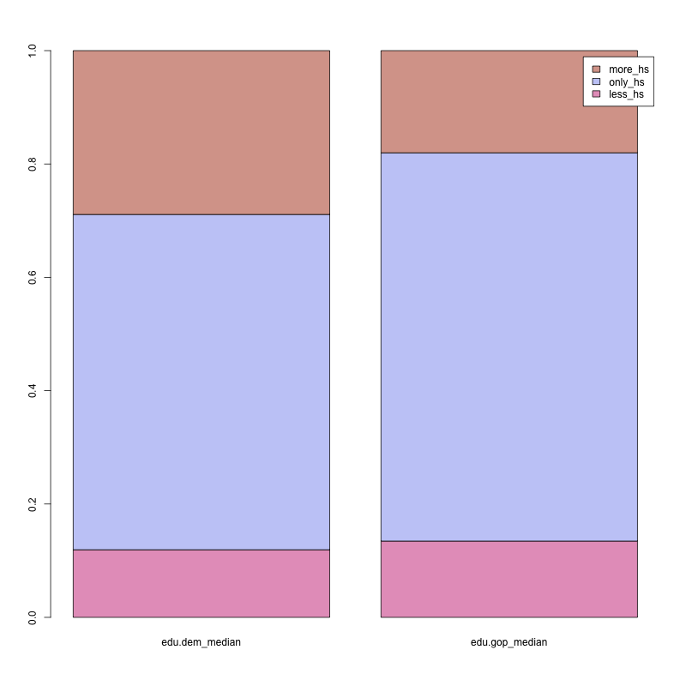
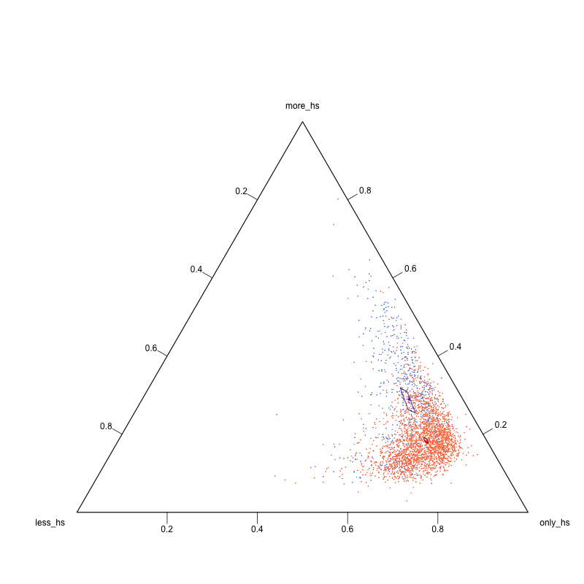
Permutational t-test: EDUCATIONAL COMPOSITION
p-val = 0

Slide 13
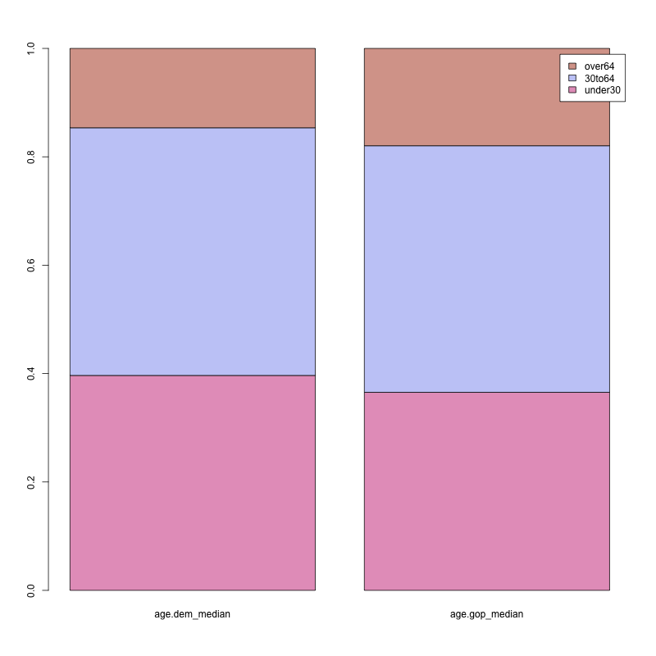
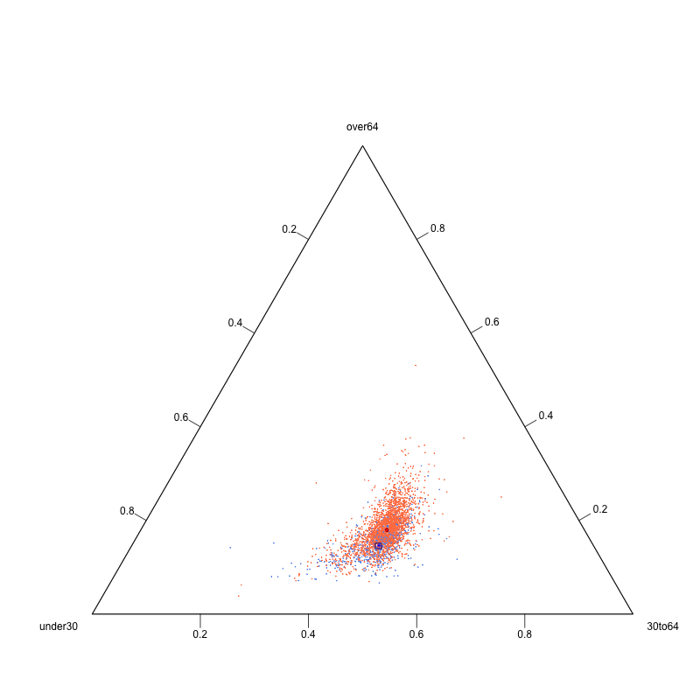
Permutational t-test: AGE COMPOSITION
p-val = 0

Slide 14
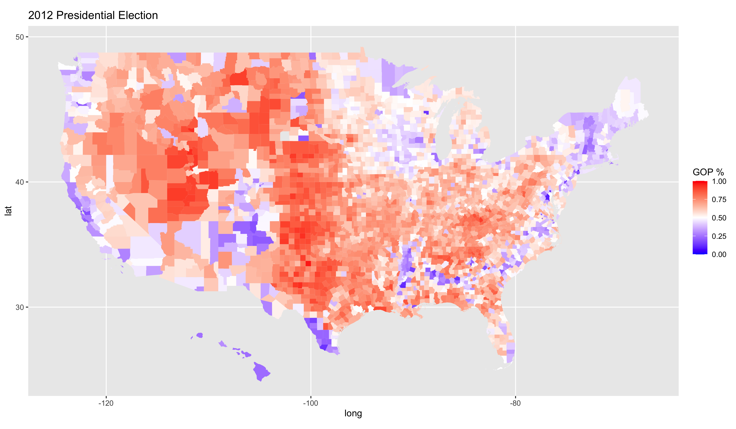
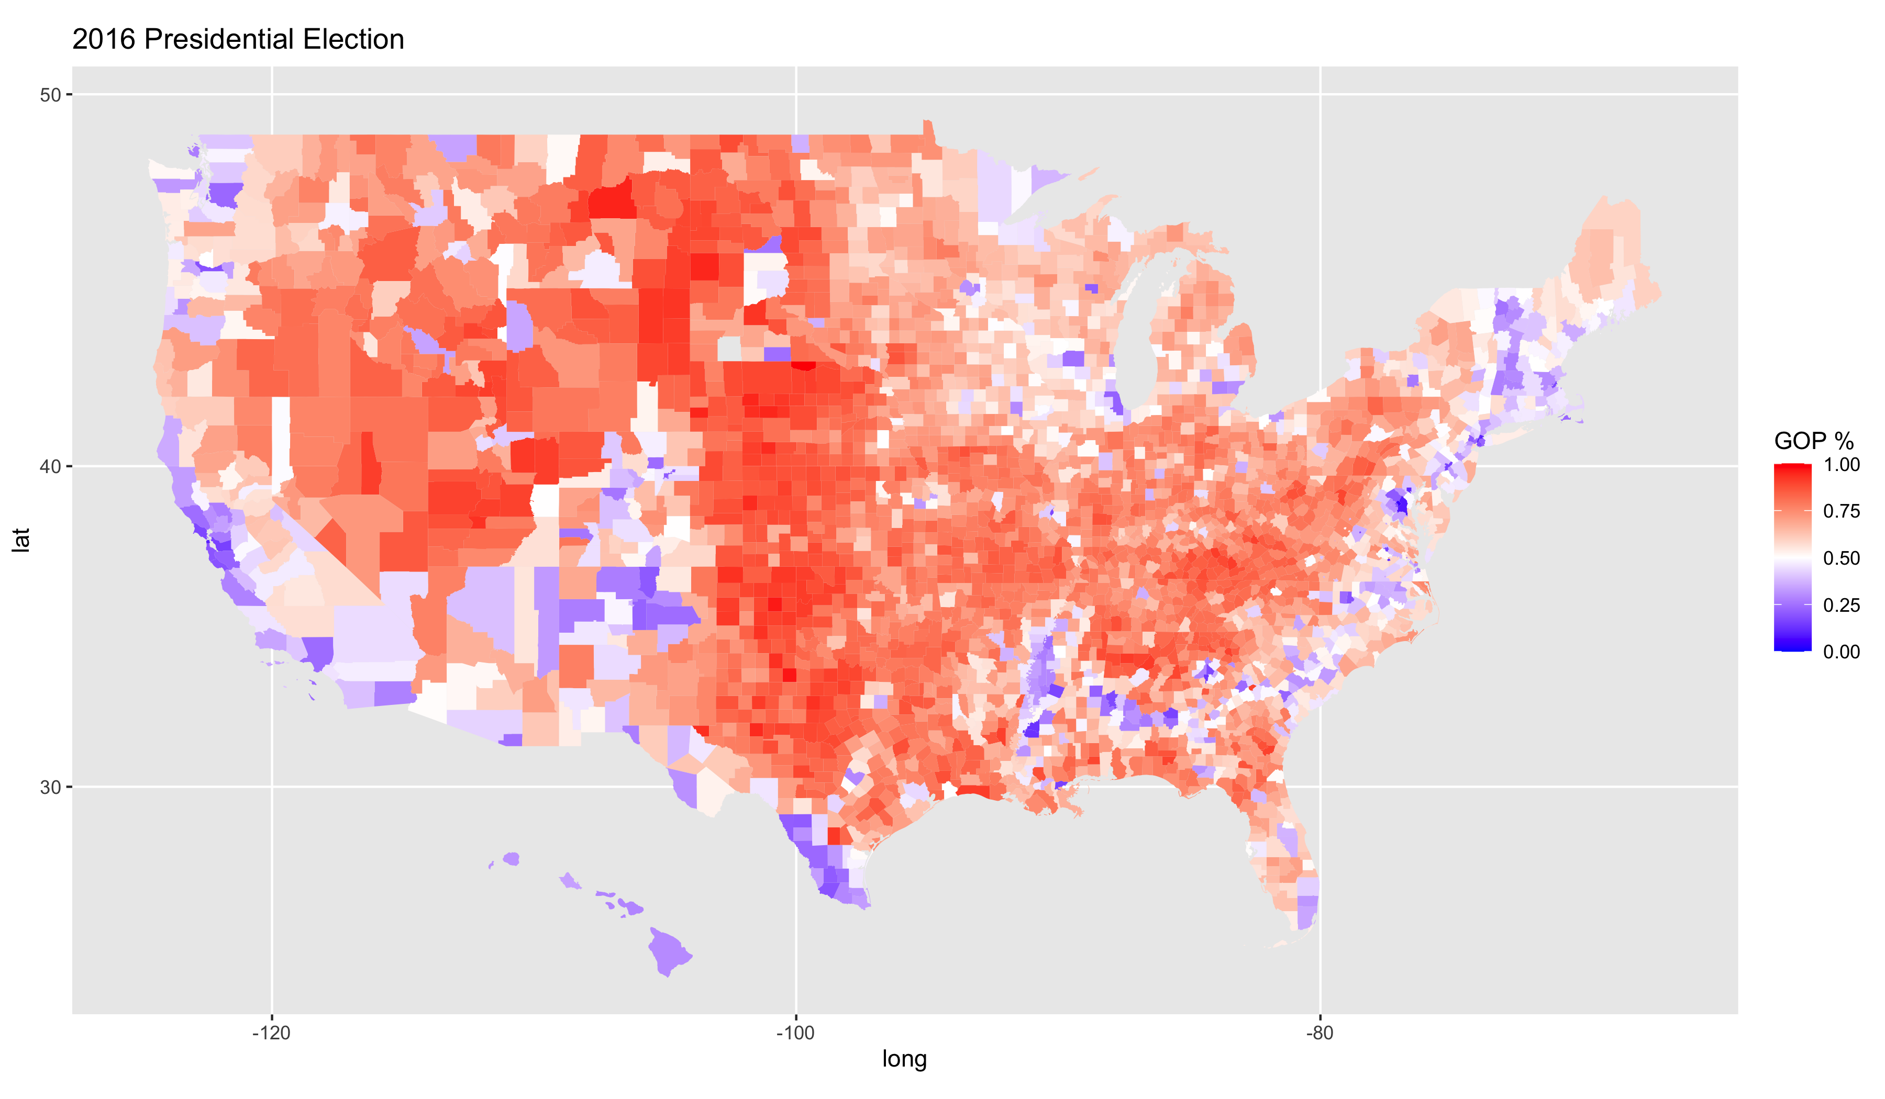
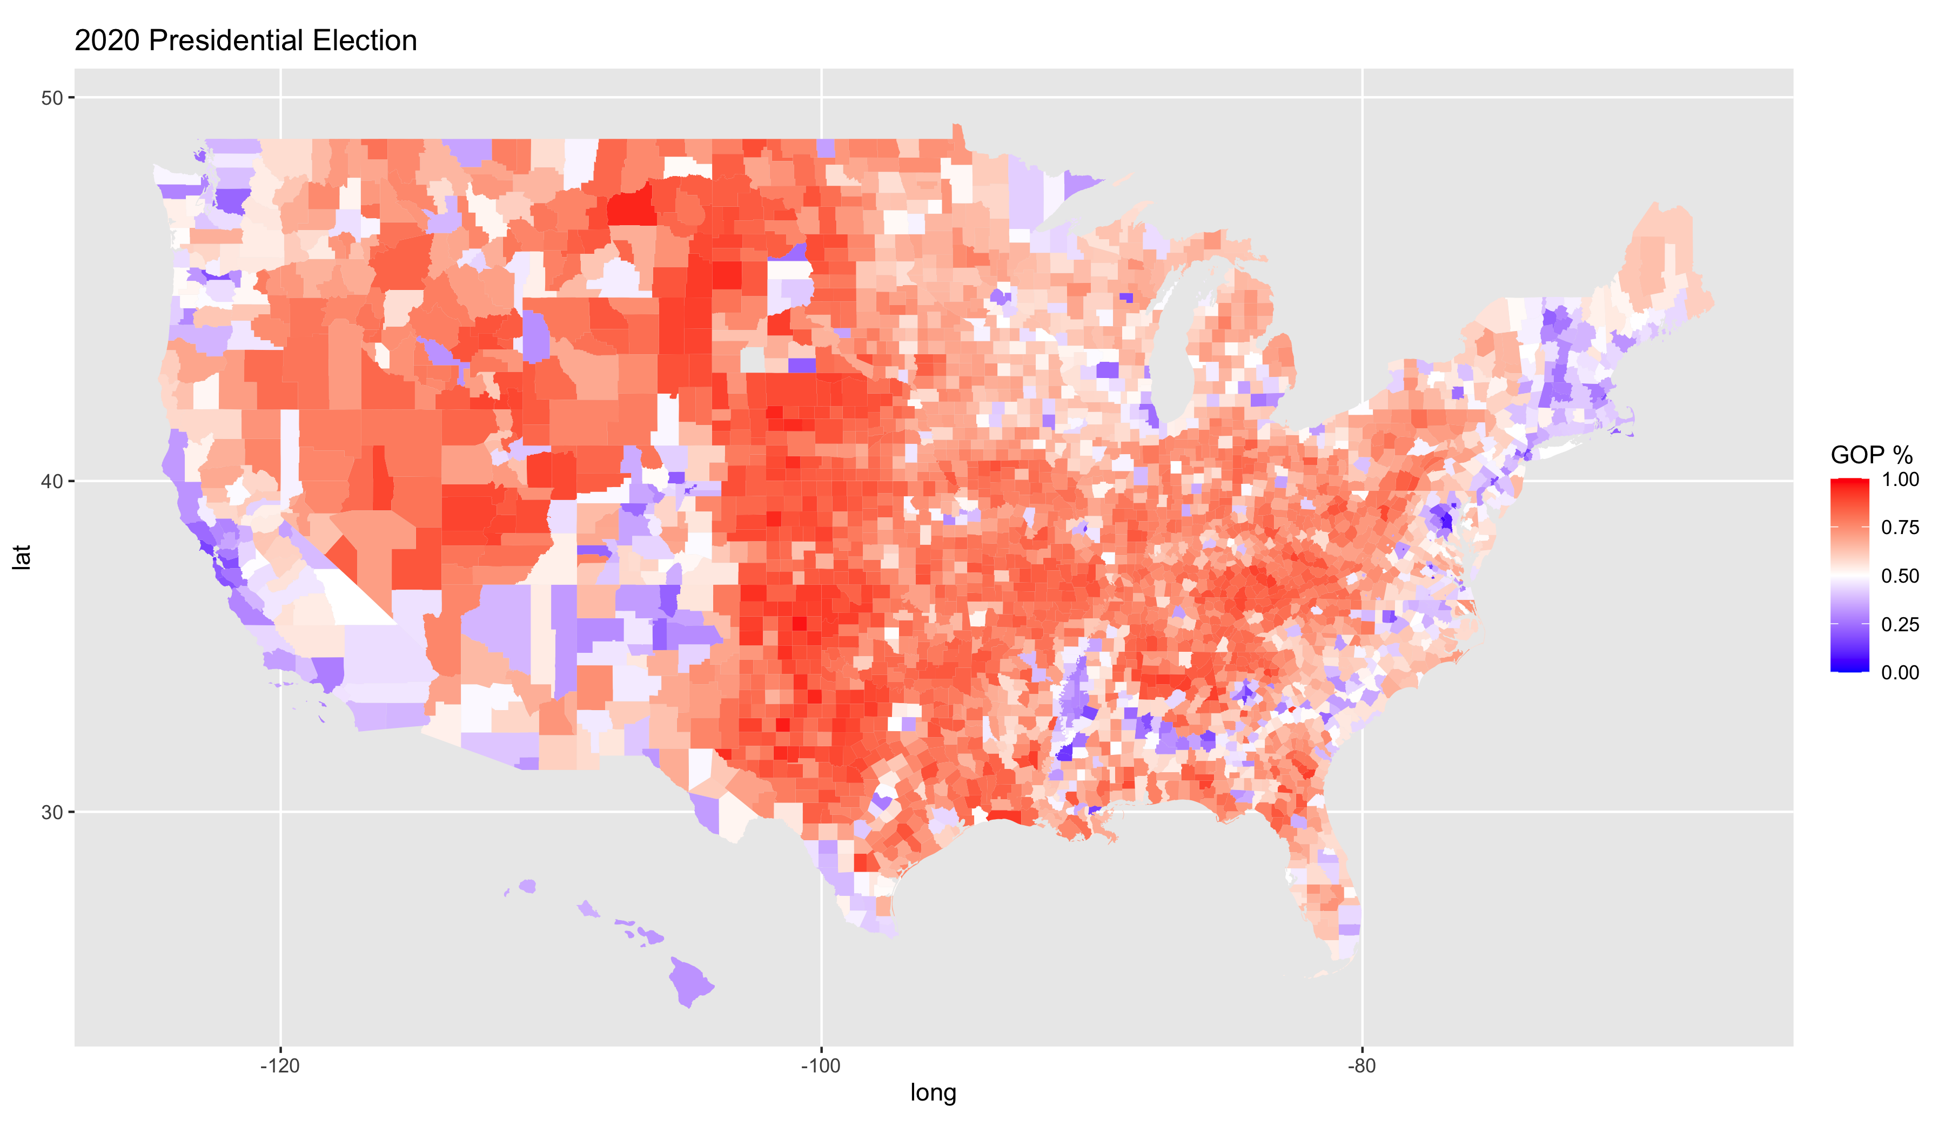
REGRESSION: TARGET
Aiming for a more general result I computed a weighted average of the three electoral results (2012, 2016, 2020)
The weighting is based on the loadings of the first component of a PCA of the three (97% original variance explained)
The result is still a proportion, so a proper regression model has to be used (beta, binomial)

Slide 15
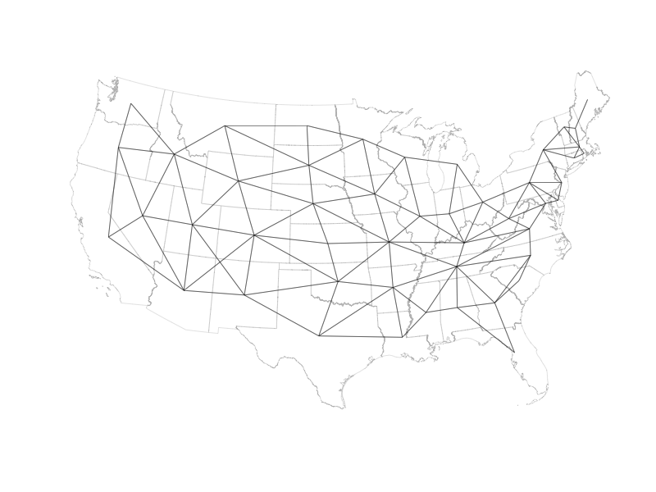
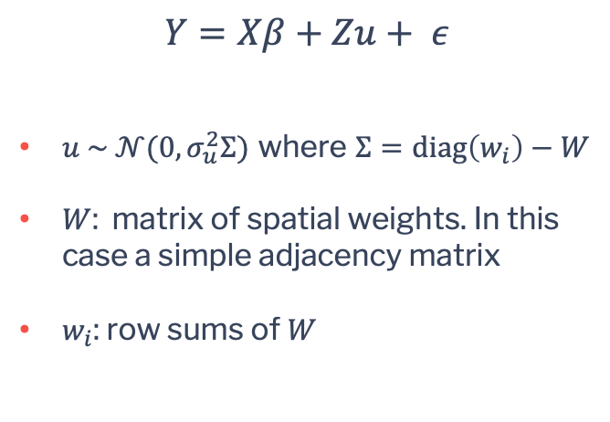
Regression: Markov random field
$$Y=Xβ+Zu+ ε$$
$u \sim 𝒩(0, σ_{u}^{2}Σ)$ where $Σ=\text{diag}\left(w_{i}\right)−W$
$W$: matrix of spatial weights. In this case a simple adjacency matrix
$w_{i}$: row sums of $W$

Slide 16
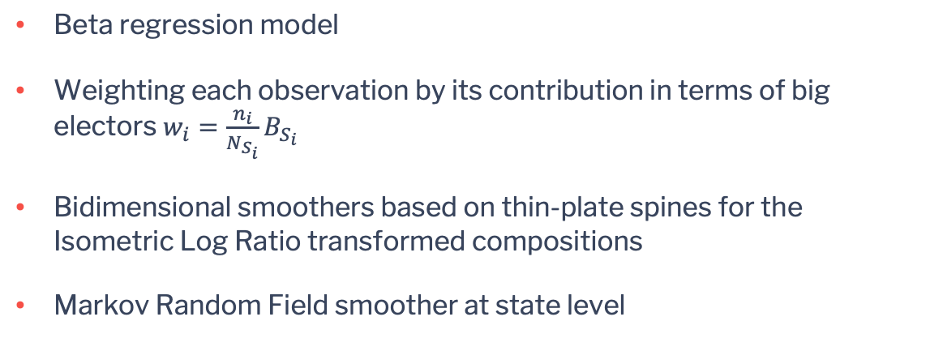
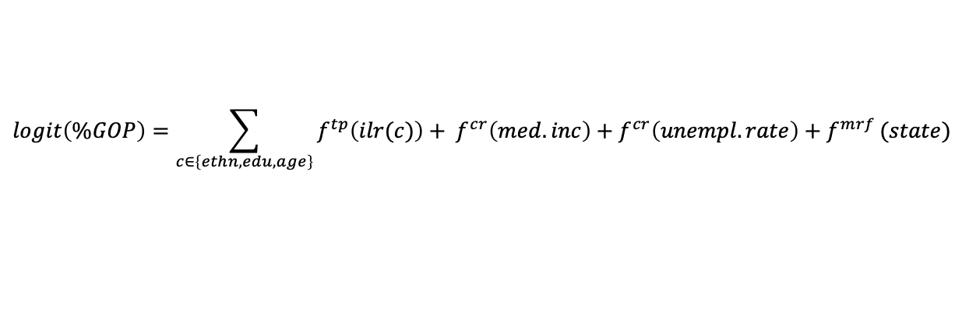
Regression: final model
$$logit\left(\%GOP\right)=\sum_{c∈\left\{ethn,edu,age\right\}}{f^{tp}\left(ilr(c)\right)+ f^{cr}\left(med.inc\right)+f^{cr}\left(unempl.rate\right)+f^{mrf}}(state)$$
Beta regression model
Weighting each observation by its contribution in terms of big electors $w_{i}=\frac{n_{i}}{N_{S_{i}}}B_{S_{i}}$
Bidimensional smoothers based on thin-plate spines for the Isometric Log Ratio transformed compositions
Markov Random Field smoother at state level

Slide 17
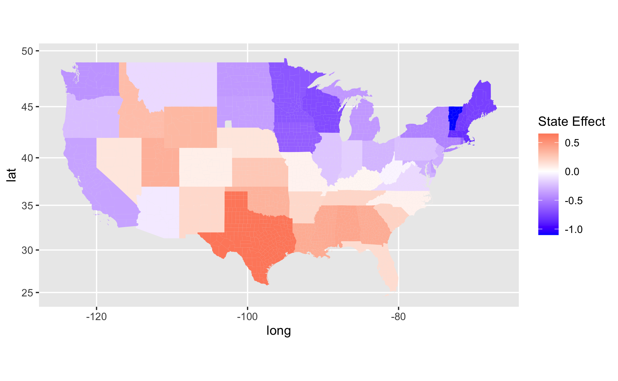
Regression: estimated effects

Slide 18
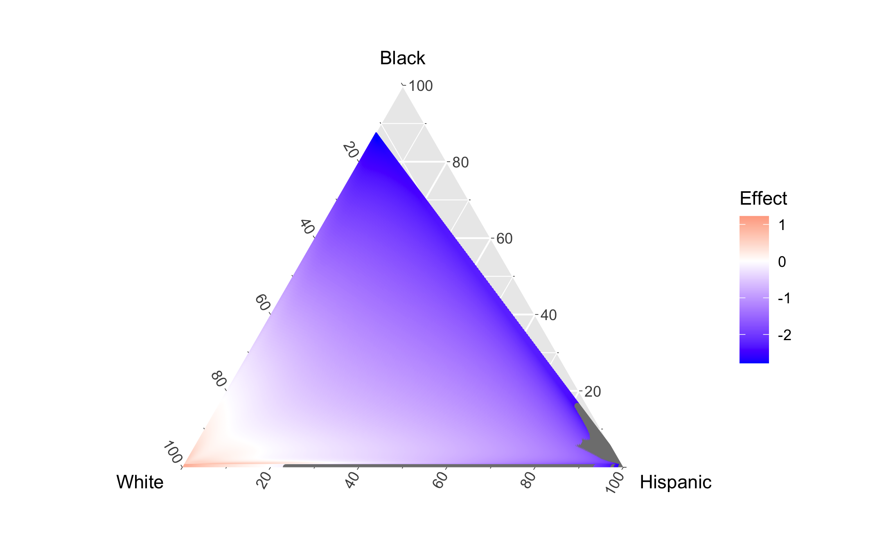
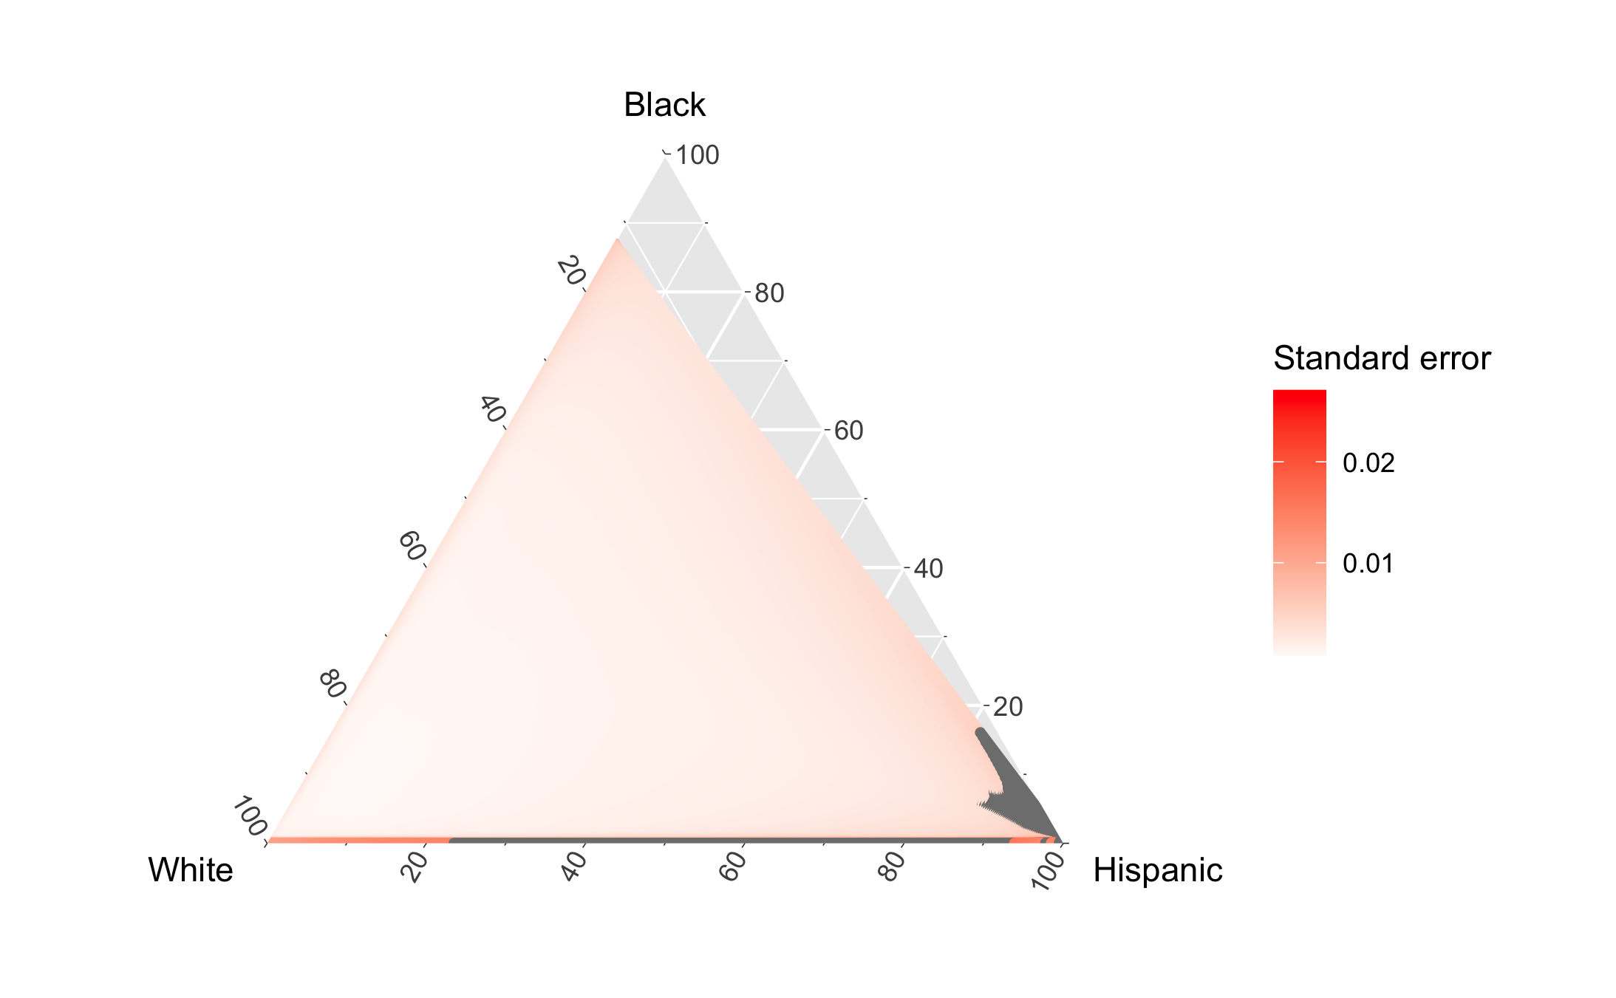
Regression: ethnicity

Slide 19
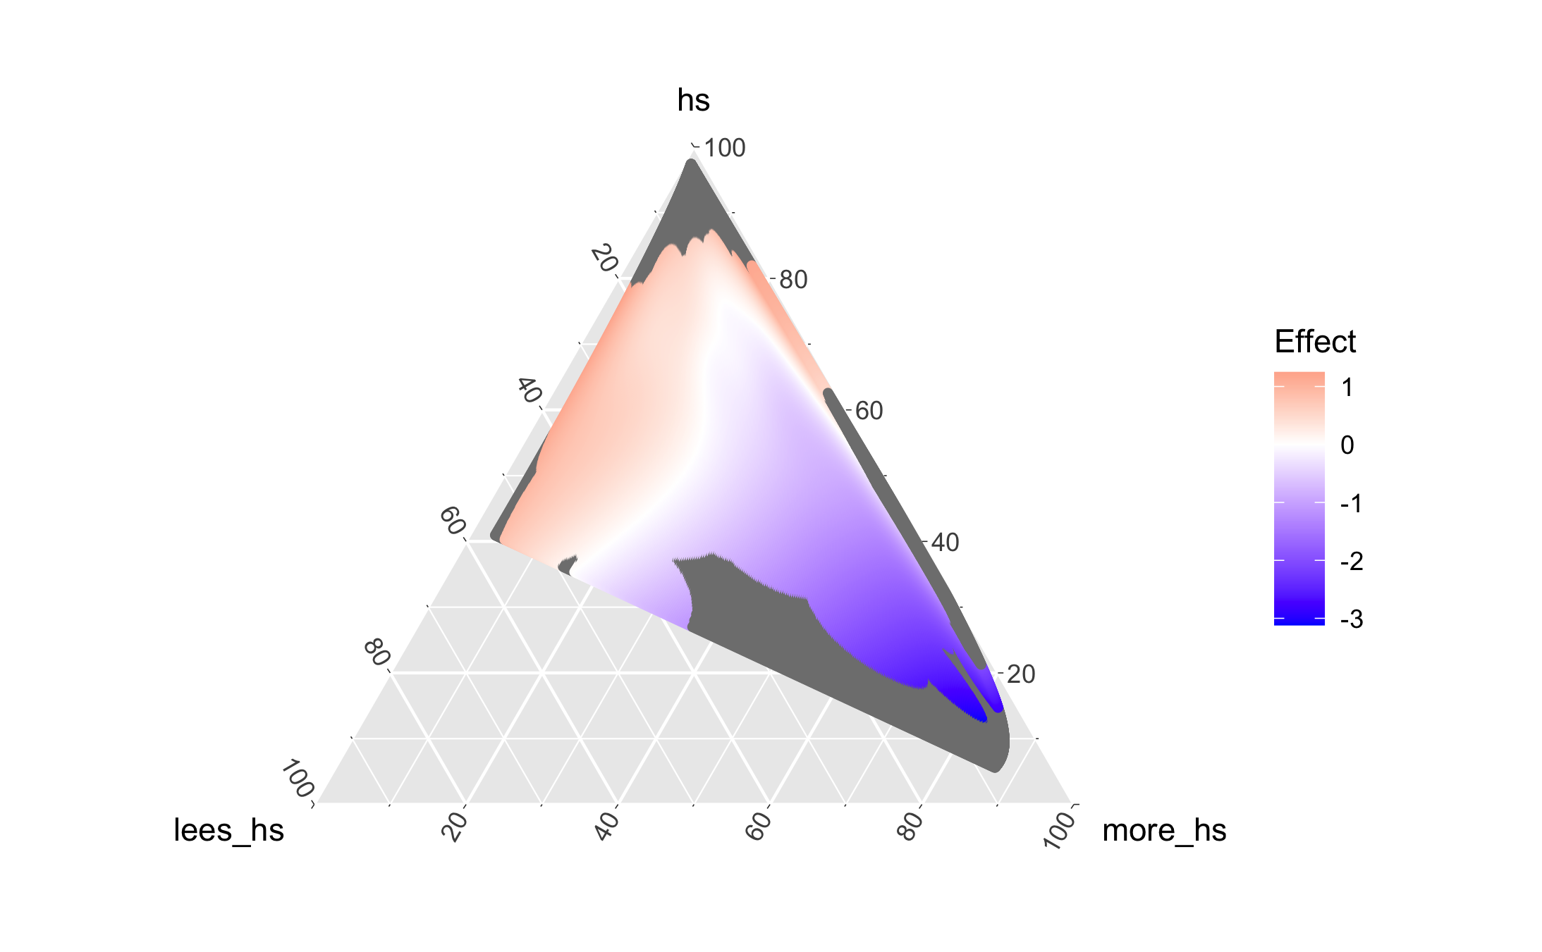
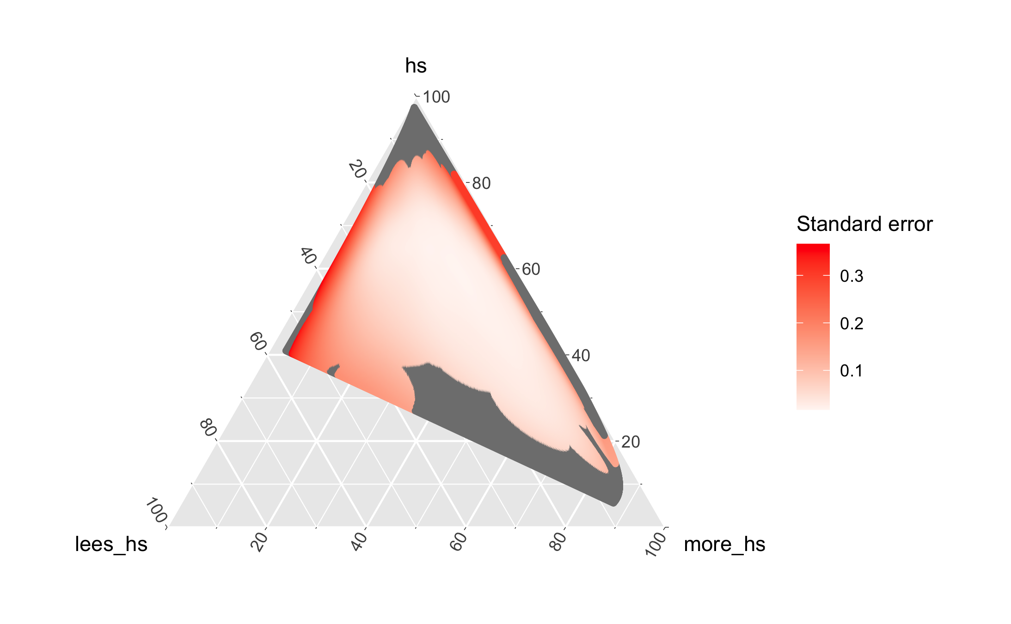
Regression: Education

Slide 20
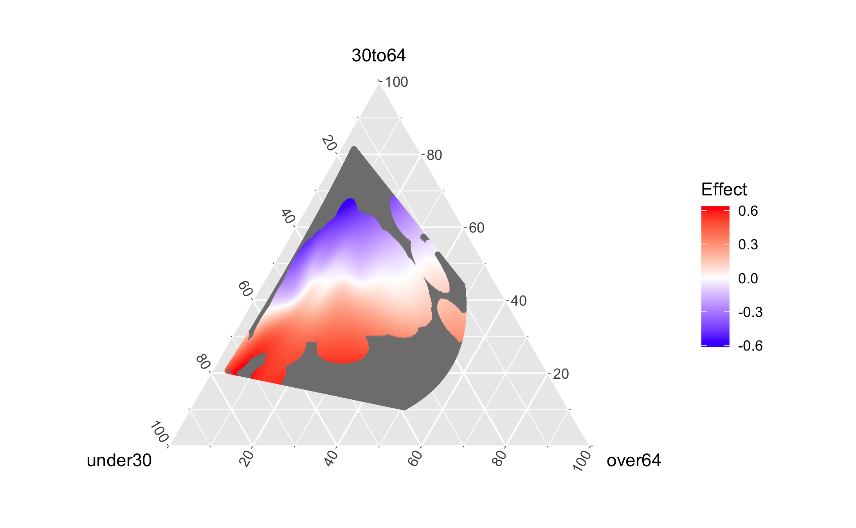
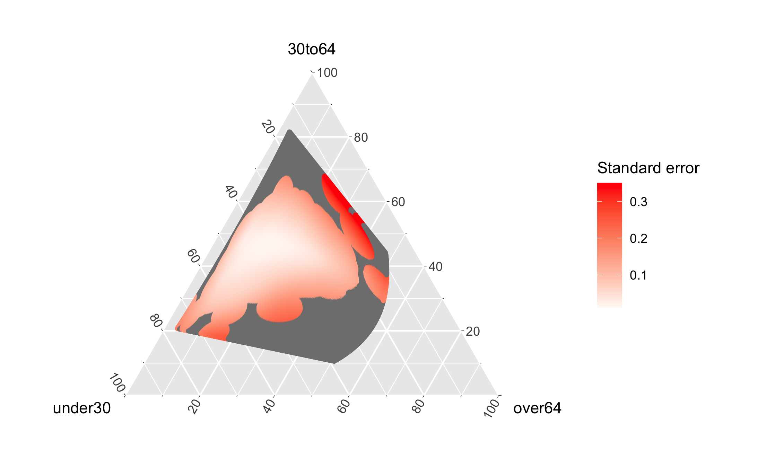
Regression: age

Slide 21
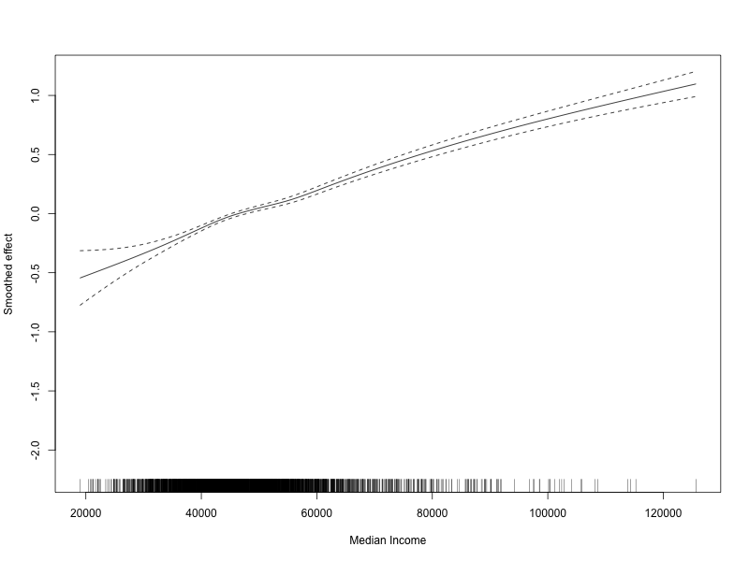
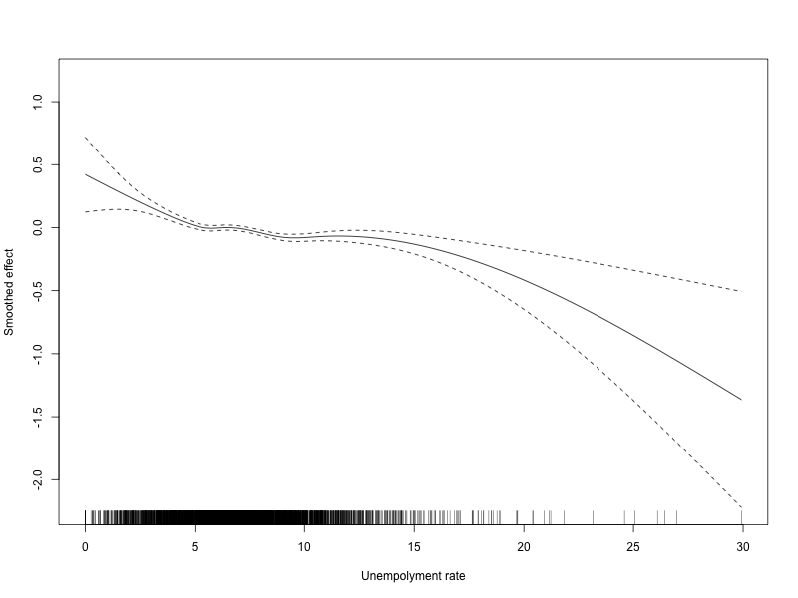
Regression: Education

Slide 22
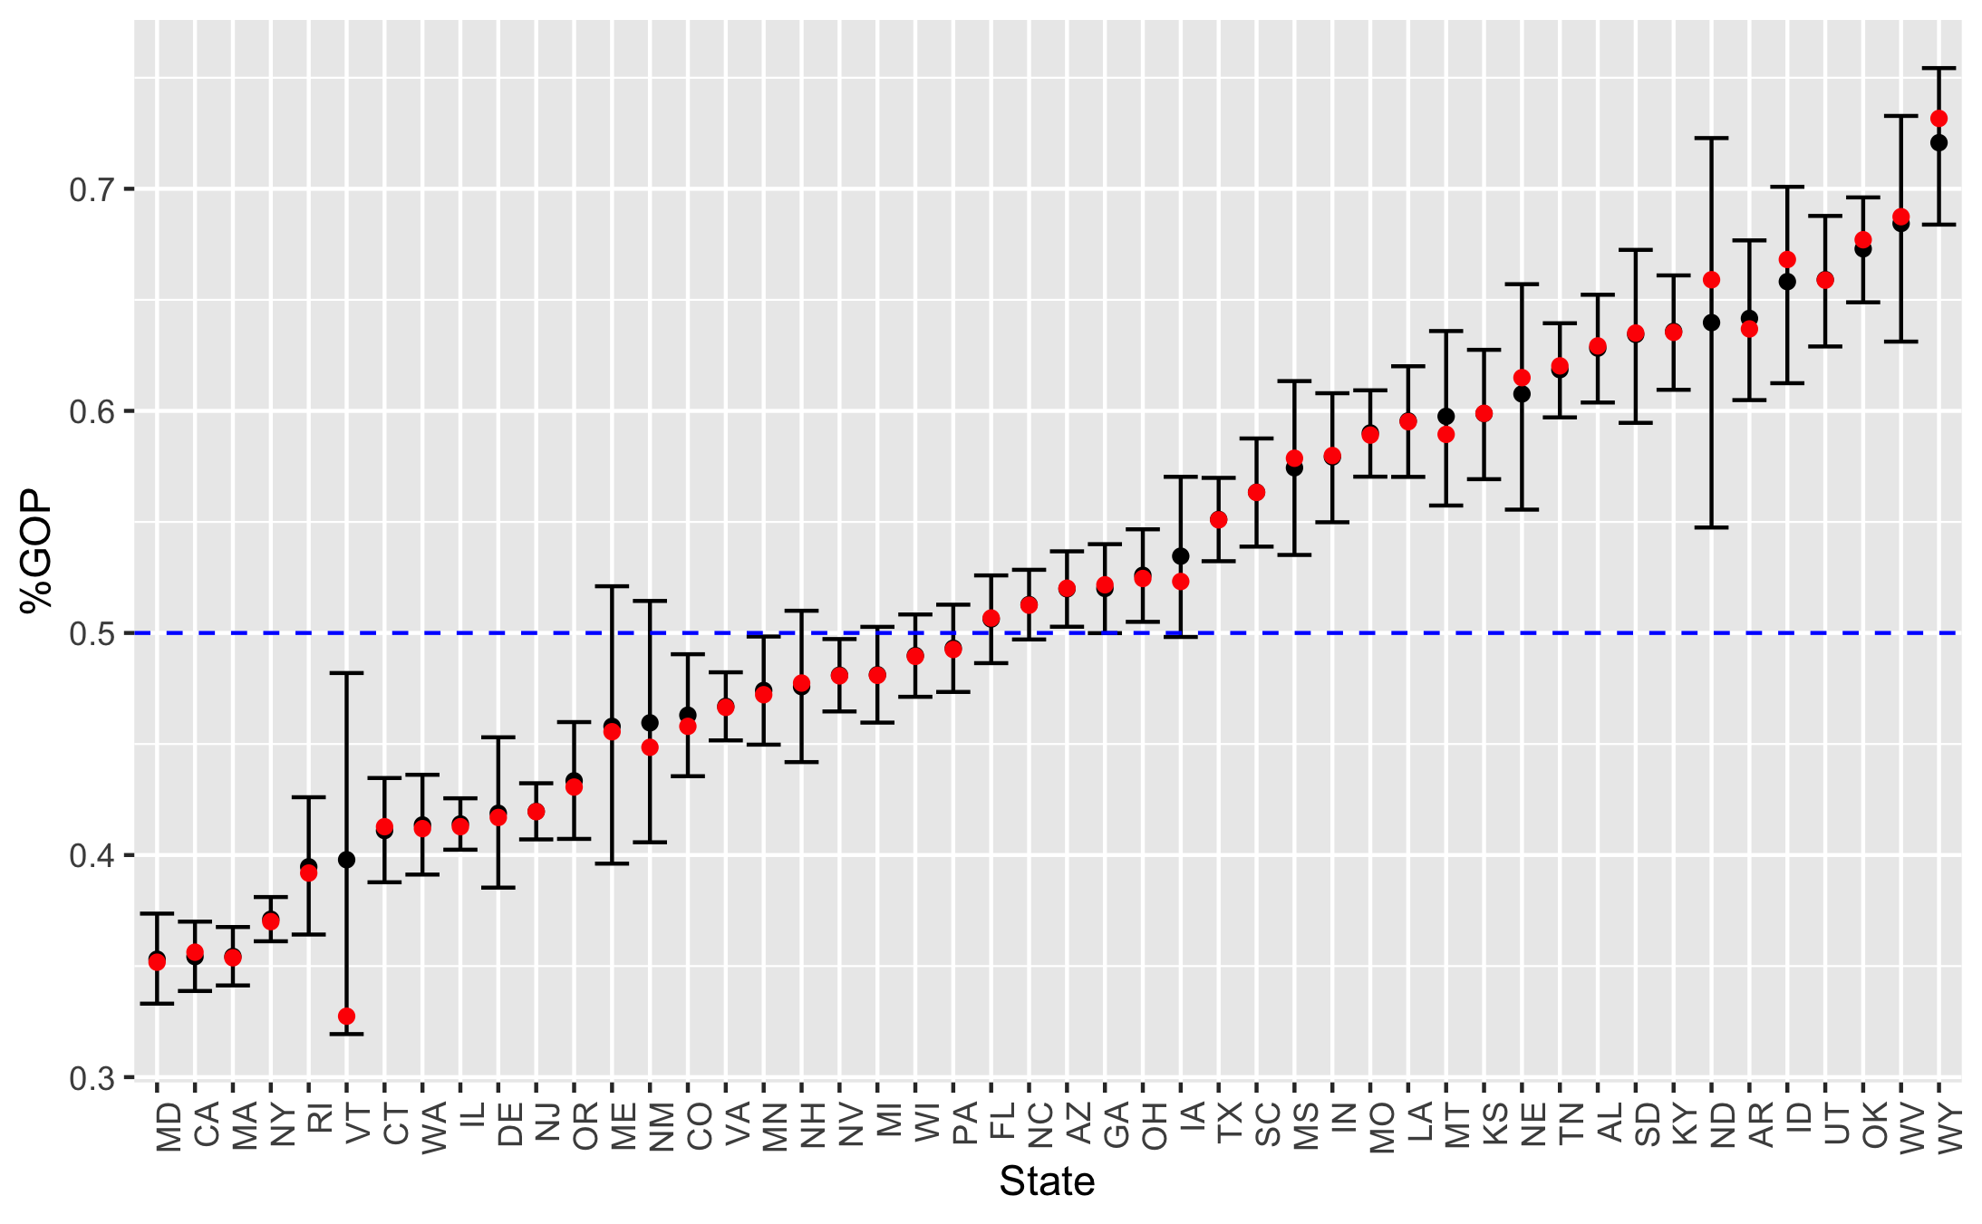
Regression: state-level Confidence Intervals

Slide 23
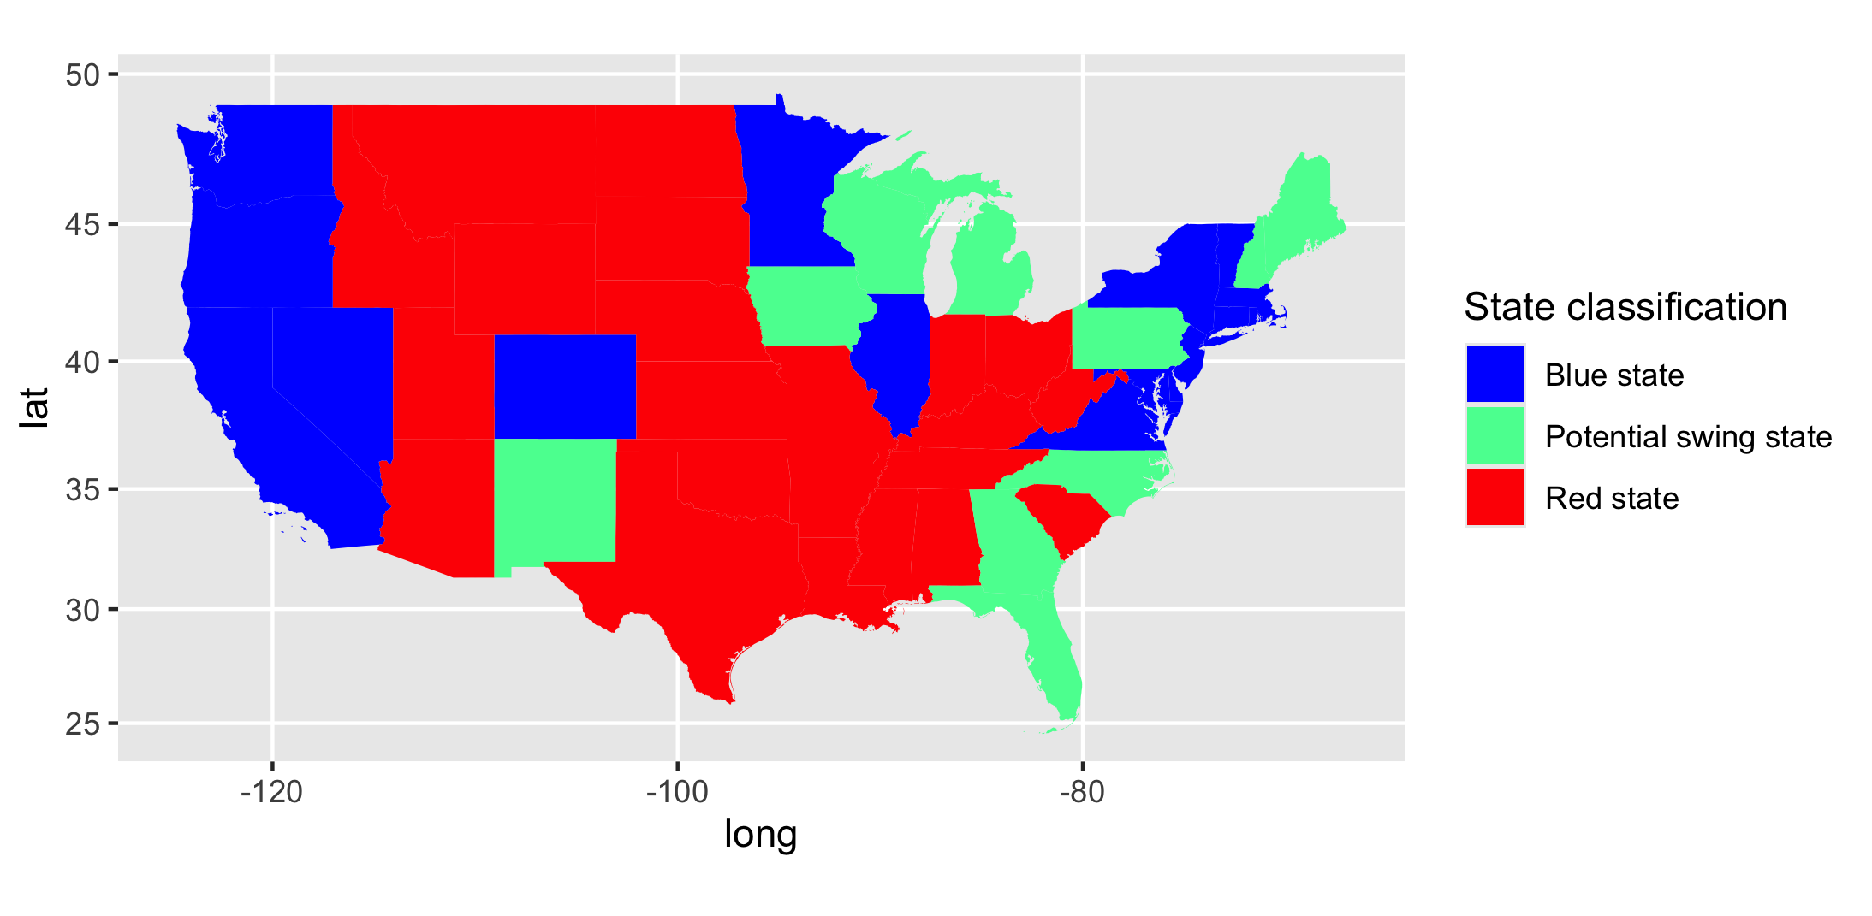
Regression: potential swing-states

Slide 24
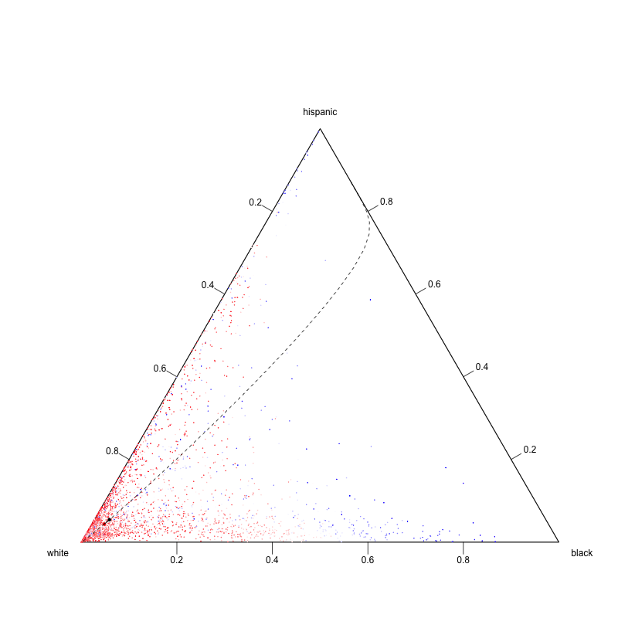
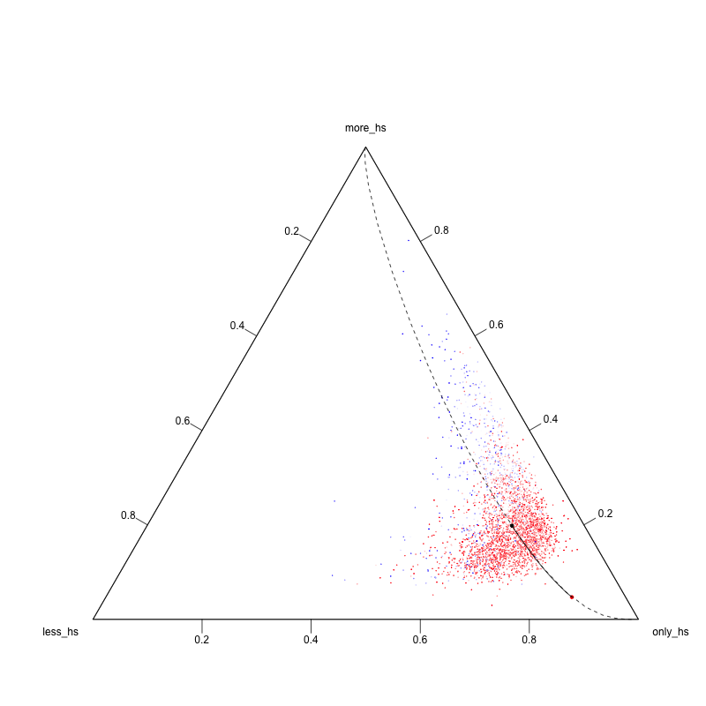
Regression: comparison to a robust model

Slide 25
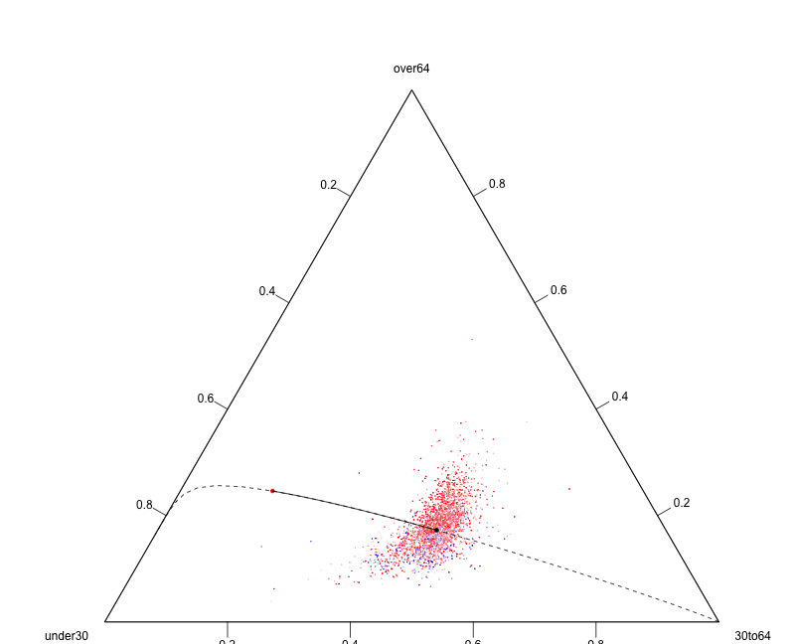
Regression: comparison to a robust model

Slide 26
Results
Summing up the main results are:
Counties with a stronger white components are associated to higher percentages of the republican party, while more etherogeneous counties are associated to a better result of the democratic party
From the educational point of view, counties with a higher presence of college-educated people are associated to more votes for the democrats
Identification of potential swing states
Modeling of the temporal relationship
Investigation of the state effect
Further developments

